Slide 1
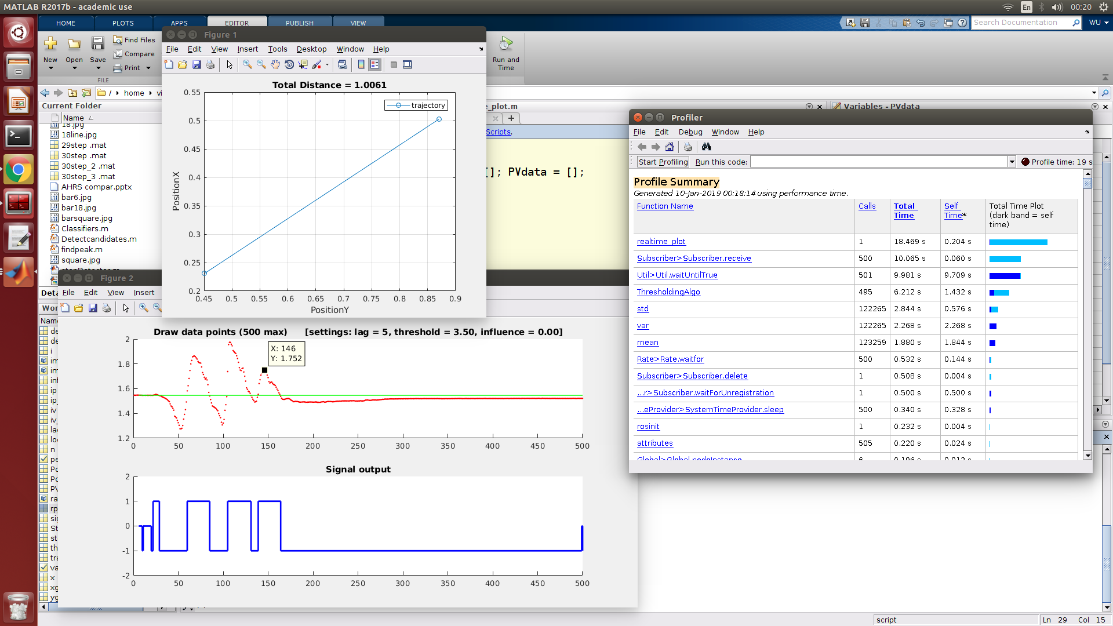
https://stackoverflow.com/questions/22583391/peak-signal-detection-in-realtime-timeseries-data/22640362#22640362

Slide 2
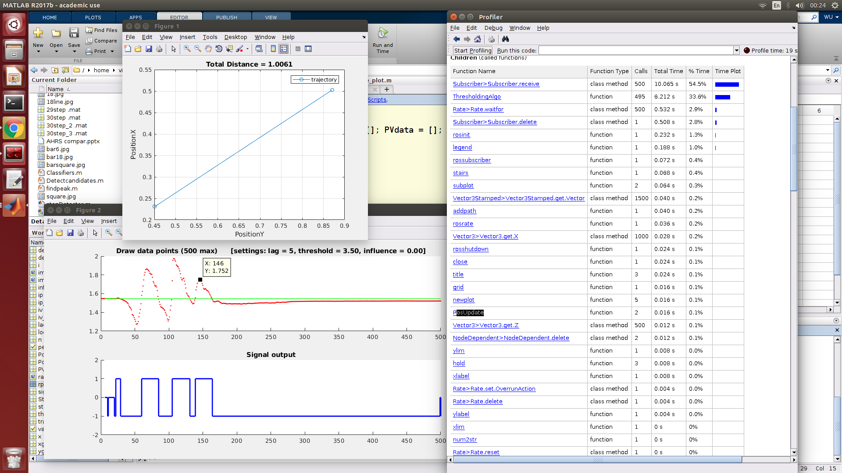

Slide 3
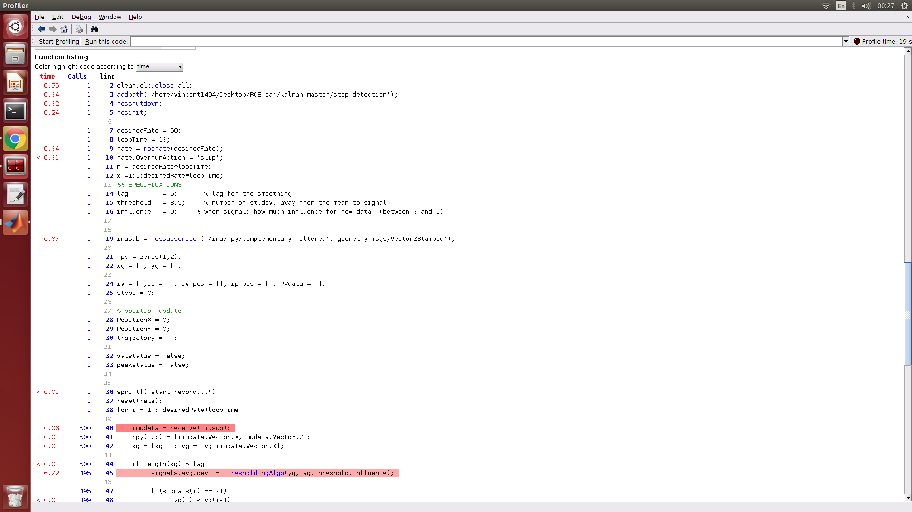
Freq = 50hz, n = 500 sample

Slide 4
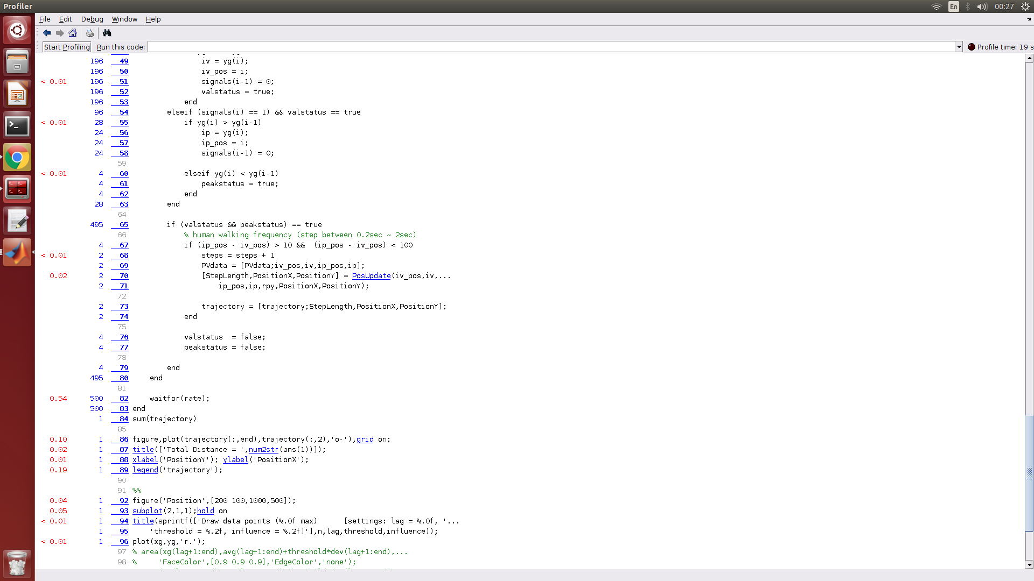

Slide 5
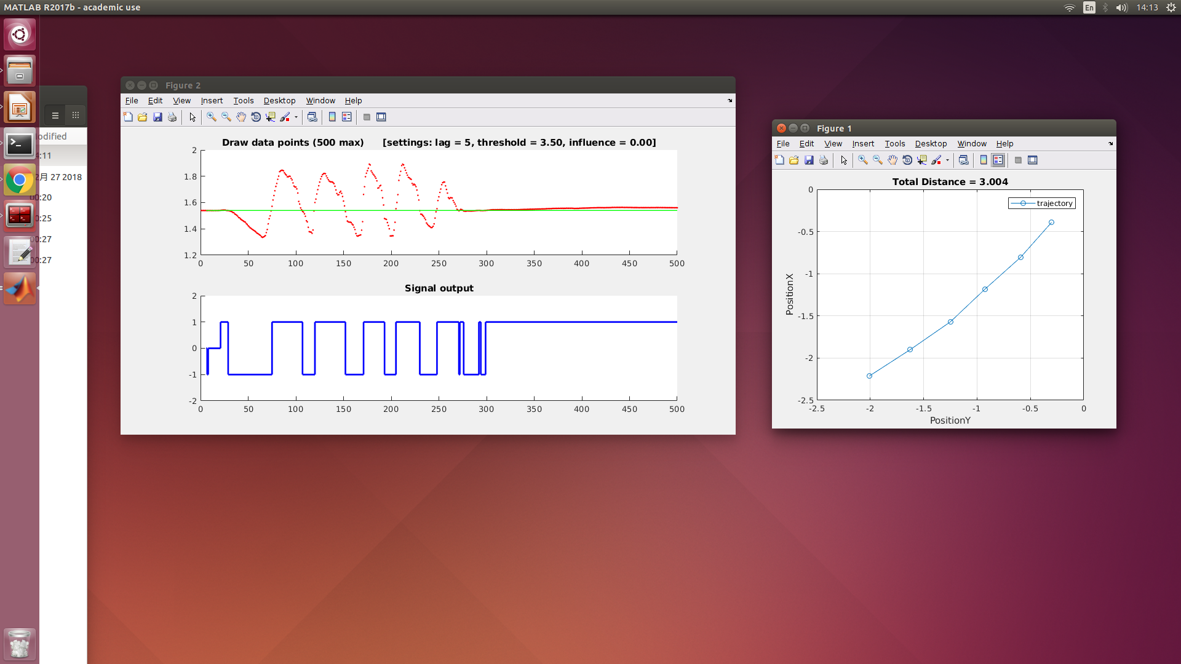
5step=5.1m(real),
Steps=6, 5.256m(estimate)

Slide 6
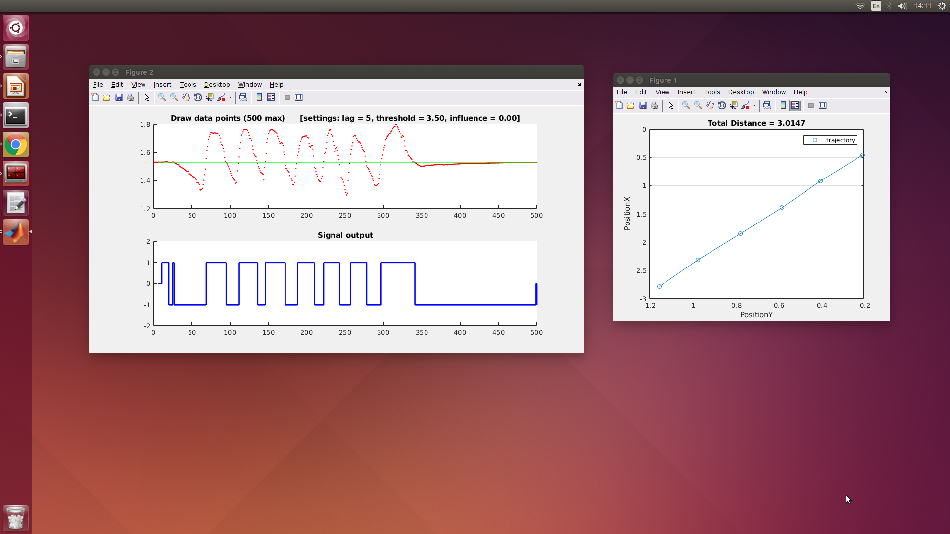
7step=6.66m(real),
Steps=6, 5.8664m(estimate)

Slide 7
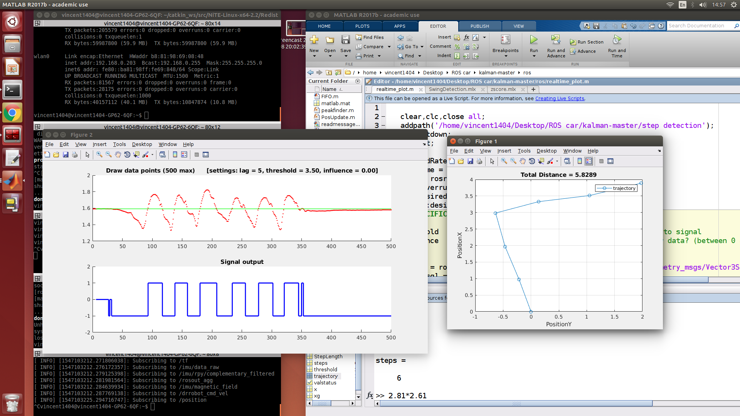
6step=5.42m(real),
Steps=6, 5.8289m(estimate)

Slide 8
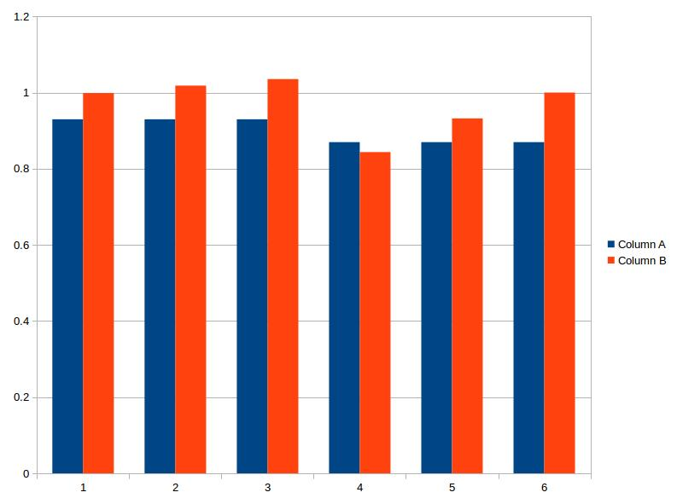
A: Real=2.81(0.93)+2.61(0.87)
B: estimate=3.0528+2.7761

